Slide 1
Data Structures & Algorithms Design- SS ZG519 Lecture - 1
Dr. Padma Murali

Slide 2
Course Description
Introduction to Abstract Data Types, Data structures and Algorithms; Analysis of Algorithms – Time and Space Complexity, Complexity Notation, Solving Recurrence Relations.; Divide-and-Conquer as a Design Technique; Recursion – Design of Recursive Functions / Procedures, Tail Recursion, Conversion of Recursive Functions to Iterative Form. Linear data structures – Lists, Access Restricted Lists (Stacks and Queues) – Implementation using Arrays and Linked Lists; Searching and Order Queries. Sorting – Sorting Algorithms (Online vs. Offline, In-memory vs. External, In-space vs. Out-of-space, QuickSort and Randomization). Unordered Collections: Hashtables (Separate Chaining vs. Open Addressing, Probing, Rehashing). Binary Trees – Tree Traversals. Partially Ordered Collections: Search Trees and Height Balanced Search Trees, Heaps and Priority Queues. Algorithm Design: Greedy Algorithms and Dynamic Programming. Graphs and Graph Algorithms: Representation schemes, Problems on Directed Graphs (Reachability and Strong Connectivity, Traversals, Transitive Closure. Directed Acyclic Graphs - Topological Sorting), Problems on Weighted Graphs (Shortest Paths. Spanning Trees). Introduction to Complexity Classes (P and NP) and NP-completeness. NP-Hard problems. Designing Algorithms for Hard Problems – Backtracking, Branch-and-Bound, and Approximation Algorithms.

Slide 3
Scope and Objective
To enable the student to develop different algorithms for a given situation, to test their validity, measure their complexity and analyze the performance (if necessary by simulation). To introduce techniques for designing data structures and algorithms.

Slide 4
Books
Prescribed Text Book
T1 Sahni, Sartaj, Data Structures, Algorithms and Application in C++, McGraw Hill International Edition, 2000 (Also in Books 24 x 7 Online Digital Library)
Reference Books
Horowitz E, Sartaj Sahni and R Sanguthevar, Computer Algorithms/C++, Second edition, Silicon Press, 2008 (Books 24 x 7 Online Digital Library)
Goodrich M T, Tamassia, R, Data Structures and Algorithms in JAVA, John Wiley & Sons Inc, 1998.
Corman T H, Leiserson, C E, and Rivest, R L, Introduction to Algorithms, MIT Press, 1990(Indian reprint: Prentice-Hall).
Aho, A V, Hopcraft, J E and Ullman, J D, The Design and Analysis of Computer Algorithms, Addison Wesley, (Indian Reprint: Pearson Education, 2002).

Slide 5
Lecture 1 Topics
Introduction to Abstract Data Type(ADT)
Data structures
Algorithms
Linear Data structures
-- Array and Linked list representations

Slide 6
Slides source:
2008 Pearson Education, Inc. Publishing as Pearson Addison-Wesley
Prepared Lecture notes

Slide 7
What is a program?
Algorithm
An algorithm is a step-by-step procedure for solving a problem in a finite amount of time.
Data Structures
Is a systematic way of organizing and accessing data, so that data can be used efficiently.
Algorithms + Data Structures = Program

Slide 8
Algorithm
An algorithm is a sequence of unambiguous instructions for solving a problem, i.e., for obtaining a required output for any legitimate input in a finite amount of time.

Slide 9
Historical Perspective
Euclid’s algorithm for finding the greatest common divisor
Muhammad ibn Musa al-Khwarizmi – 9th century mathematician www.lib.virginia.edu/science/parshall/khwariz.html
Notes:
Euclid’s algorithm is good for introducing the notion of an algorithm because it
makes a clear separation from a program that implements the algorithm.
It is also one that is familiar to most students.
Al Khowarizmi (many spellings possible...) – “algorism” (originally) and then
later “algorithm” come from his name.

Slide 10
Notion of algorithm
problem
algorithm
“computer”
input
output
Algorithmic solution

Slide 11
Example of computational problem: sorting
Statement of problem:
Input: A sequence of n numbers <a₁, a₂, …, a_{n}>
Output: A reordering of the input sequence <a´₁, a´₂, …, a´_{n}> so that a´_{i} ≤ a´_{j} whenever i < j
Instance: The sequence <5, 3, 2, 8, 3>
Algorithms:
Selection sort
Insertion sort
Merge sort
(many others)

Slide 12
Selection Sort
Input: array a[1],…,a[n]
Output: array a sorted in non-decreasing order
Algorithm:
for i=1 to n
swap a[i] with smallest of a[i],…a[n]
see also pseudocode, section 3.1
Notes:
The algorithm is given *very* informally here. Show students the pseudocode in
section 3.1.
This is a good opportunity to discuss pseudocode conventions.

Slide 13
Some Well-known Computational Problems
Sorting
Searching
Shortest paths in a graph
Minimum spanning tree
Primality testing
Traveling salesman problem
Knapsack problem
Chess
Towers of Hanoi
Program termination
Notes:
1-4 have well known efficient (polynomial-time) solutions
5: primality testing has recently been found to have an efficient solution
This is a great problem to discuss because it has recently been in the news
(see mathworld news at: http://mathworld.wolfram.com/news/2002-08-07_primetest/
or original article: http://www.cse.iitk.ac.in/primality.pdf)
6(TSP)-9(chess) are all problems for which no efficient solution has been found
it is possible to informally discuss the “try all possibilities” approach that is required
to get exact solutions to such problems
10: Towers of Hanoi is a problem that has only exponential-time solutions (simply
because the output required is so large)
11: Program termination is undecidable

Slide 14
Basic Issues Related to Algorithms
How to design algorithms
How to express algorithms
Proving correctness
Efficiency
Theoretical analysis
Empirical analysis
Optimality

Slide 15
Algorithm design strategies
Brute force
Divide and conquer
Decrease and conquer
Transform and conquer
Greedy approach
Dynamic programming
Backtracking and Branch and bound
Space and time tradeoffs

Slide 16
Analysis of Algorithms
How good is the algorithm?
Correctness
Time efficiency
Space efficiency
Does there exist a better algorithm?
Lower bounds
Optimality

Slide 17
What is an algorithm?
Recipe, process, method, technique, procedure, routine,… with following requirements:
Finiteness
terminates after a finite number of steps
Definiteness
rigorously and unambiguously specified
Input
valid inputs are clearly specified
Output
can be proved to produce the correct output given a valid input
Effectiveness
steps are sufficiently simple and basic
Notes:
The formalization of the notion of an algorithm led to great breakthroughs in the
foundations of mathematics in the 1930s.

Slide 18
Why study algorithms?
Theoretical importance
the core of computer science
Practical importance
A practitioner’s toolkit of known algorithms
Framework for designing and analyzing algorithms for new problems

Slide 19
Euclid’s Algorithm
Problem: Find gcd(m,n), the greatest common divisor of two nonnegative, not both zero integers m and n
Examples: gcd(60,24) = 12, gcd(60,0) = 60, gcd(0,0) = ?
Euclid’s algorithm is based on repeated application of equality
gcd(m,n) = gcd(n, m mod n)
until the second number becomes 0, which makes the problem
trivial.
Example: gcd(60,24) = gcd(24,12) = gcd(12,0) = 12
Notes:
Euclid’s algorithm is good for introducing the notion of an algorithm because it
makes a clear separation from a program that implements the algorithm.
It is also one that is familiar to most students.
Al Khowarizmi (many spellings possible...) – “algorism” (originally) and then
later “algorithm” come from his name.

Slide 20
Two descriptions of Euclid’s algorithm
Step 1 If n = 0, return m and stop; otherwise go to Step 2
Step 2 Divide m by n and assign the value fo the remainder to r
Step 3 Assign the value of n to m and the value of r to n. Go to Step 1.
while n ≠ 0 do
r ← m mod n
m← n
n ← r
return m

Slide 21
Other methods for computing gcd(m,n)
Consecutive integer checking algorithm
Step 1 Assign the value of min{m,n} to t
Step 2 Divide m by t. If the remainder is 0, go to Step 3; otherwise, go to Step 4
Step 3 Divide n by t. If the remainder is 0, return t and stop; otherwise, go to Step 4
Step 4 Decrease t by 1 and go to Step 2

Slide 22
Other methods for gcd(m,n) [cont.]
Middle-school procedure
Step 1 Find the prime factorization of m
Step 2 Find the prime factorization of n
Step 3 Find all the common prime factors
Step 4 Compute the product of all the common prime factors and return it as gcd(m,n)
Is this an algorithm?

Slide 23
Why study algorithms?
Theoretical importance
the core of computer science
Practical importance
A practitioner’s toolkit of known algorithms
Framework for designing and analyzing algorithms for new problems

Slide 24
Two main issues related to algorithms
How to design algorithms
How to analyze algorithm efficiency

Slide 25
Algorithm design techniques/strategies
Brute force
Divide and conquer
Decrease and conquer
Transform and conquer
Space and time tradeoffs
Greedy approach
Dynamic programming
Iterative improvement
Backtracking
Branch and bound

Slide 26
Analysis of algorithms
How good is the algorithm?
time efficiency
space efficiency
Does there exist a better algorithm?
lower bounds
optimality

Slide 27
Algorithmic problem
Specification of output as a function of input
Specification of input
?
???
For eg: Sorting of integers
Input Instance : 8,4 ,5,2,10
Output Instance as a permutation of input : 2,4,5,8,10

Slide 28
Algorithmic Solution
?
Specification of input
Specification of output
ALGORITHM
Algorithm describes actions on the input instance.
Infinitely many correct algorithm for the same problem.
Infinite number of input instances satisfying the specification.
Two key points: Repeatable argument & Correctness

Slide 29
What is good algorithm?
Resources Used
Running time
Space used
Resource Usage
Measured proportional to (input) size

Slide 30
Measuring the running time
Write a program implementing the algorithm.
Run the program with inputs of varying size and composition.
Use a method like System.currentTimeMillis() to get an accurate measure of the actual running time.

Slide 31
Limitations of experimental studies
Implementation is a must.
Execution is possible on limited set of inputs.
If we need to compare two algorithms we need to use the same environment
(like hardware, software etc)

Slide 32
Analytical model to analyze algorithm
Algorithm should be analyzed by using general methodology.
This approach uses:
High level description of the algorithm.
Takes into account all possible inputs.
Allows one to evaluate the efficiency of any algorithm in a way that is independent of the hardware and the software environment.

Slide 33
Pseudo-code
A mixture of natural language and high level programming concepts that describes the main ideas behind a generic implementation of a data structure and algorithms.
Algorithm arrayMax(A, n)
Input: An array A of n integers
Output: The maximum element of A
currentMax ←A[0]
for i ← 1 to n - 1 do
if A[i] > currentMax then currentMax ← A[i]
return currentMax

Slide 34
Pseudo-code
Is structured than usual prose but less formal than a programming language.
Expressions
Use standard mathematical symbols to describe numeric and Boolean expressions.
Uses for assignment.
Use = for the equality relationship.
Method declaration
Algorithm name(param1,param2…)

Slide 35
Important problem types
sorting
searching
string processing
graph problems
combinatorial problems
geometric problems
numerical problems

Slide 36
Fundamental data structures
list
array
linked list
string
stack
queue
priority queue
graph
tree
set and dictionary

Slide 37
Assumptions
Individual statement considered as “unit” time
Not applicable for function calls and loops
Individual variable considered as “unit” storage
Often referred to as “algorithmic complexity”

Slide 38
Data structures: conceptual and concrete ways to organize data for efficient storage and efficient manipulation
Employment of this data structures in the design of efficient algorithms

Slide 39
Methodology
Algorithm analysis techniques
Algorithm design techniques
Implementation/analysis of data structures:
Lists, stacks, and queues
Trees
Hashing
Priority queues (heaps)
Sorting
Graphs

Slide 40
Why to Study Data Structures?
Any organization has a collection of records that can be
searched, processed in any order, or modified.
Data structures organize data:
Good choice: more efficient programs
Bad choice: poor program performance
The choice can make a difference between the program running in a few seconds or many day
Characteristics of a problem’s solution
efficient: if it solves problem within resource constraints
time
space
Cost: amount of resources a solution consumes

Slide 41
Costs and Benefits
A data structure requires a certain amount of:
space for each data item it stores
time to perform a single basic operation
programming effort.

Slide 42
Selecting a Data Structure
Select a data structure as follows:
Analyze the problem to determine the resource constraints a solution must meet.
Determine the basic operations that must be supported. Quantify the resource constraints for each operation.
Select the data structure that best meets these requirements.

Slide 43
Abstract Data Types (ADT)
A logical view of the data objects together with specifications of the operations required to create and manipulate them.
Describe an algorithm – pseudo-code
Describe a data structure – ADT
A data structure is the physical implementation of an ADT
Each ADT operation is implemented by one or more
subroutines
Data structures are used to organize data in main memory

Slide 44
Data Type
ADT:
Type
Operations
Data Items:
Logical Form
Data Structure:
Storage Space
Subroutines
Data Items:
Physical Form

Slide 45
Problems, Algorithms and Programs
Programmers deal with:
problems,
algorithms and
computer programs.

Slide 46
Problems, Algorithms and Programs
Problem: a task to be performed.
Best thought of as inputs and matching outputs.
Problem definition should include constraints on the resources that may be consumed by any acceptable solution.
Problems ⇔ mathematical functions
A function is a matching between inputs (the domain) and outputs (the range).
An input to a function may be single number, or a collection of information.
The values making up an input are called the parameters of the function.
A particular input must always result in the same output every time the function is computed.

Slide 47
Problems, Algorithms and Programs
Algorithm: a method or a process followed to solve a problem.
A recipe: The algorithm gives us a “recipe” for solving the problem by performing a series of steps, where each step is completely understood and can be implemented.
An algorithm takes the input to a problem (function) and transforms it to the output.
A mapping of input to output.
A problem can be solved by many algorithms.

Slide 48
Problems, Algorithms and Programs
For example, the problem of sorting can be solved by the
following algorithms:
Insertion sort
Bubble sort
Selection sort
Shellsort
Mergesort
Others

Slide 49
Problems, Algorithms and Programs
An algorithm possesses the following properties:
It must be correct.
It must be composed of a series of concrete steps.
There can be no ambiguity as to which step will be performed next.
It must be composed of a finite number of steps.
It must terminate.
A computer program is an instance, or concrete representation, for an algorithm in some programming language.

Slide 50
Algorithm Design Techniques
The design of algorithms is also an important
focus.
Types of algorithms:
Greedy algorithms
Divide and Conquer
Dynamic programming
Randomized algorithms
Backtracking

Slide 51
Algorithm Analysis
Predict the amount of resources required:
memory: how much space is needed?
computational time: how fast the algorithm runs?
FACT: running time grows with the size of the input
Input size (number of elements in the input)
Size of an array, polynomial degree, # of elements in a matrix, # of bits in the binary representation of the input, vertices and edges in a graph
Def: Running time = the number of primitive operations (steps) executed before termination
Running time is expressed as T(n) for some function T on input size n.

Slide 52
Algorithm Analysis
Two approaches to obtaining running time:
Measuring under standard benchmark conditions.
Estimating the algorithms performance
Estimation is based on:
The “size” of the input
The number of basic operations
The time to complete a basic operation does not depend on the value of its operands.

Slide 53
Abstract Data Types (ADT)
A data type can be considered abstract when it is defined in terms of operations on it, and its implementation is hidden.
Examples of ADT
List
Stack
Queue

Slide 54
Abstract Data Type
Abstract Data Type
In computer science, an abstract data type
(ADT) is a mathematical model for a certain
class of data structures that have similar
behavior.

Slide 55
Abstract Data Types (ADTs)
A method for achieving abstraction for data structures and algorithms
ADT = model + operations
Describes what each operation does, but not how it does it
An ADT is independent of its implementation

Slide 56
Abstract Data Types
Typical operations on data
Add data to a data collection
Remove data from a data collection
Ask questions about the data in a data collection
Notes:
Our data structures should be abstractions
That is, they should hide unneeded details
We want to separate the interface of the structure from its underlying implementation
This helps manage complexity and makes it possible to change the implementation without changing the interface
What do we mean by “makes it possible to change the implementation without changing the interface“?
Why is changing the implementation without changing the interface desirable?

Slide 57
Abstract Data Types
Data abstraction
Asks you to think what you can do to a collection of data independently of how you do it
Allows you to develop each data structure in relative isolation from the rest of the solution
A natural extension of procedural abstraction
Notes:
In Java, an interface corresponds
well to an ADT
􀂃 The interface describes the
operations, but says nothing at all
about how they are implemented
􀁹 Example: Stack interface/ADT
public interface Stack {
public void push(Object x);
public Object pop();
public Object peek();
public boolean isEmpty();
public void makeEmpty();
}

Slide 58
Examples
Simple ADTs
Stack
Queue
Vector
Lists
Sequences
Iterators
All these are called Linear Data Structures

Slide 59
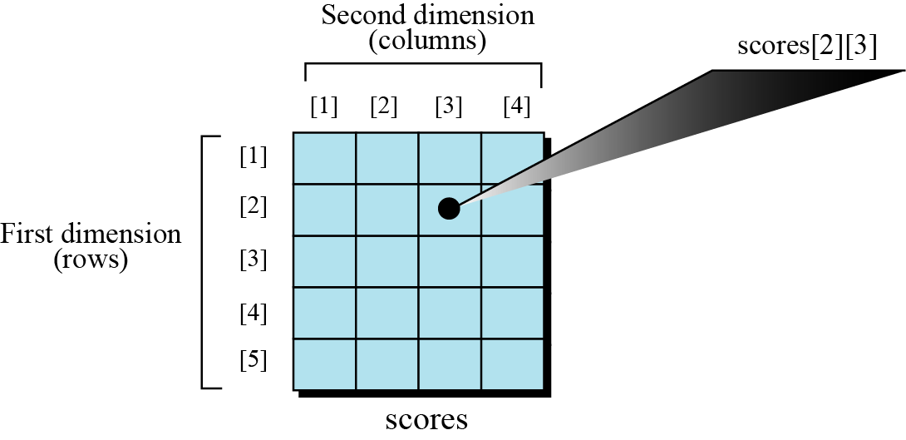
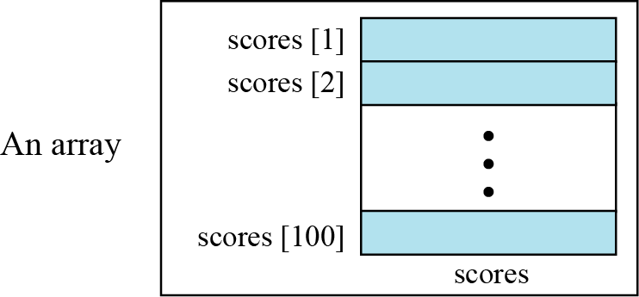
Array Data Structure
An array is a sequenced collection of elements, normally of the same data type.
Single-dimensional
Multi-dimensional

Slide 60
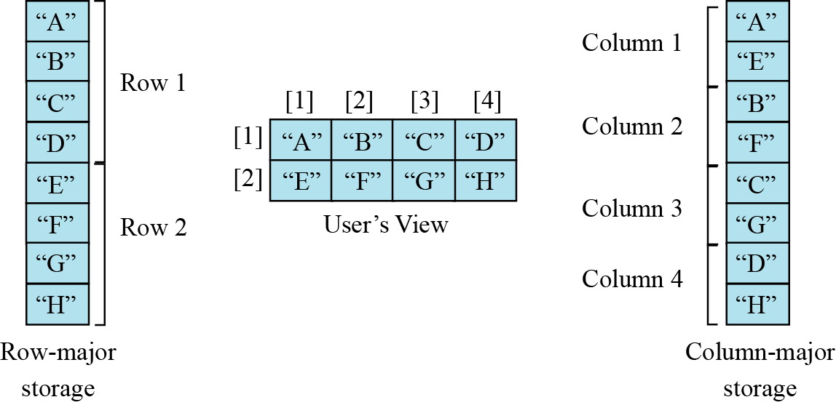
Memory layout
The index in an one-dimensional array directly define the relative positions of the element in actual memory.
two-dimensional array is stored in memory using row-major or column-major storage

Slide 61
We have stored the two-dimensional array students in memory. The array is 100 × 4 (100 rows and 4 columns). Show the address of the element students[5][3] assuming that the element student[1][1] is stored in the memory location with address 1000 and each element occupies only one memory location. The computer uses row-major storage.

Slide 62
Operations on array
The common operations on arrays as structures are searching, insertion, deletion and traversal.
An array is more suitable when the number of deletions and insertions is small, but a lot of searching and retrieval activities are expected.

Slide 63
Example
We have stored the two-dimensional array students in memory. The array is 100 × 4 (100 rows and 4 columns). Show the address of the element students[5][3] assuming that the element student[1][1] is stored in the memory location with address 1000 and each element occupies only one memory location. The computer uses row-major storage.
Solution
We can use the following formula to find the location of an element, assuming each element occupies one memory location.
If the first element occupies the location 1000, the target element occupies the location 1018.

